Slide 1

FIFA Mini Project!
Group 3
Gladys, Evangelos, Jordi

Slide 2
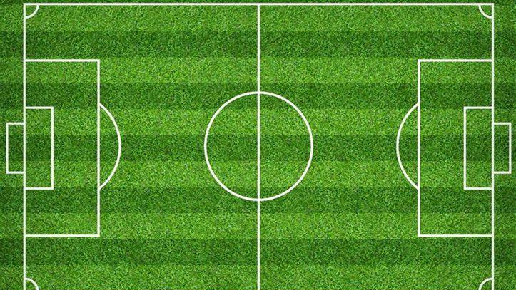
Hypothesis:
How to predict the best player?
The best are defined by:
How long they last on the field
Their reaction time to intercept / attack / defend
Support to teammates
Of course, overall rating

Slide 3
Data Selection
Columns that are related to overall performance in the field
We omit the use of hit, heading,dribbling as these features can be biased against the position the player is playing.
Name ; age ; OVA ; BOV ; POT ; Growth ; Total Stats ; Base Stats ; Composure ; Stamina ; Strength ; Power ; Reactions ; A/W ; D/W

Slide 4
Modifications to DataFrame
Replace null values with median (Composure column)
Remove null values from
Attacking Work Rate (A/W)
Defending Work Rate (D/W)
Correlation analysis
EDA
Search for outliers (and remove)
One-Hot-Encoding of A/W & D/W

Slide 5
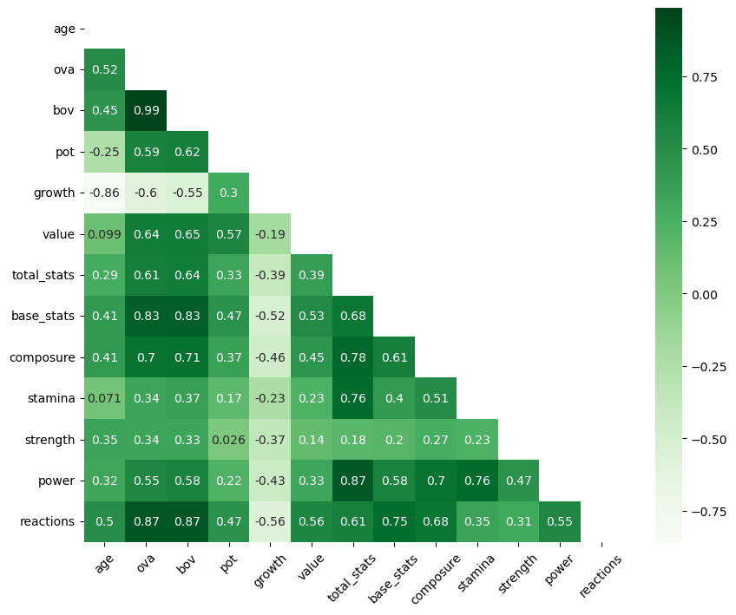
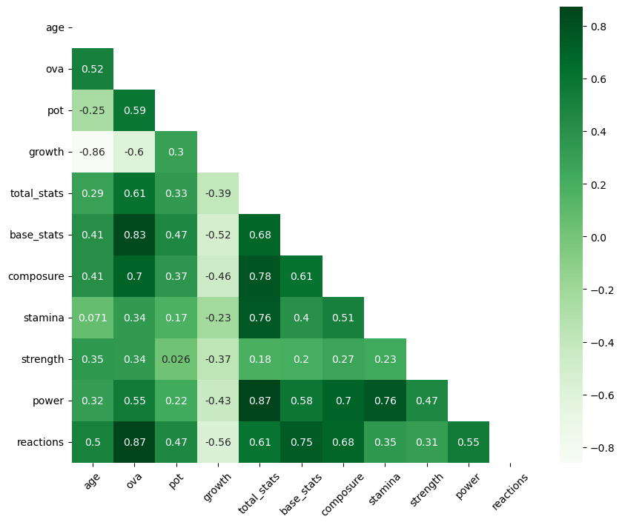
Modifications to
DataFrame

Slide 6

Some sophisticated data handling later...

Slide 7
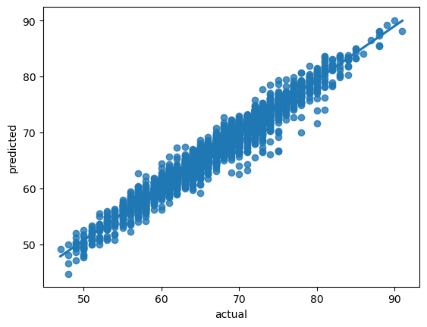
Conclusion: Is our model reliable?
R2 = 0.95
Great fit!
RMSE = 1.49
Predicted values grouped & close to central
curve
→ very slight or no surprises to expect
MAE = 1.14
Average error between original and predicted
value: not bad :)
Linear Regression
an appropriate means to perform predictions

Slide 8
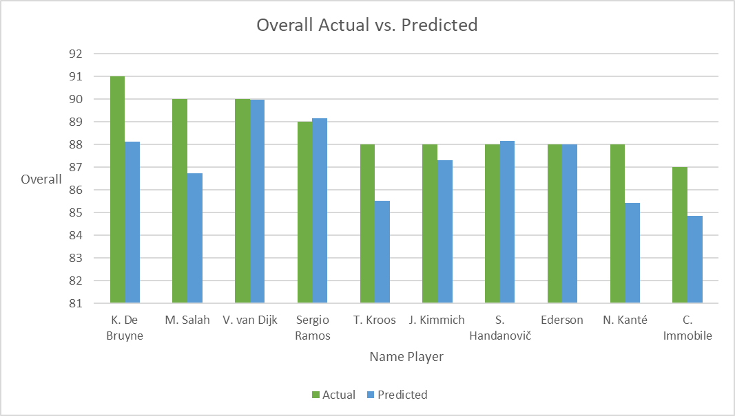
Top 10 Actual vs Predicted!

Slide 9
Top 10 Actual vs Predicted revealed
Name | Actual | Predicted | Difference
K. De Bruyne | 91 | 88.12 | 2.88
M. Salah | 90 | 86.72 | 3.28
V. van Dijk | 90 | 89.98 | 0.02
Sergio Ramos | 89 | 89.16 | 0.16
T. Kroos | 88 | 85.52 | 2.48
J. Kimmich | 88 | 87.31 | 0.69
S. Handanovič | 88 | 88.15 | 0.15
Ederson | 88 | 88.02 | 0.02
N. Kanté | 88 | 85.44 | 2.56
C. Immobile | 87 | 84.85 | 2.15
Name | Predicted | Difference
V. van Dijk | 89.98 | 0.02
Sergio Ramos | 89.16 | 0.16
S. Handanovič | 88.15 | 0.15
K. De Bruyne | 88.12 | 2.88
Ederson | 88.02 | 0.02
J. Kimmich | 87.31 | 0.69
M. Salah | 86.72 | 3.28
A. Robertson | 86.51 | 0.49
David Silva | 85.72 | 0.28
T. Kroos | 85.52 | 2.48

